Slide 1
System Panic
Presenters:
Layla Hoey - Producer
Antony Pinto - Level Design Lead

Slide 2
Agenda

Slide 3
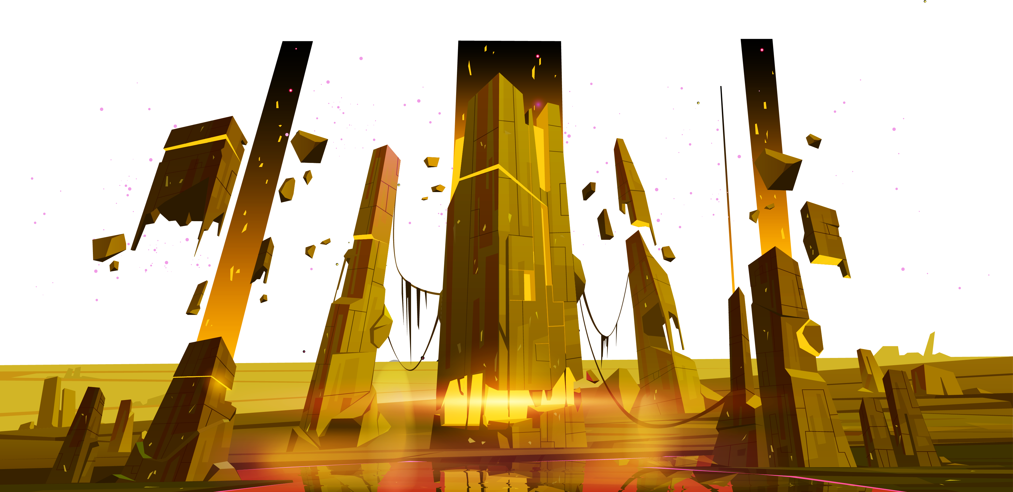
Concept (todo)

Slide 4
Design Pillars
High replay value
Emergent strategy
Procedural Generation
RNG
Choose-your-own difficulty
Very sparse checkpoints
High risk, High reward
On losing, player feels responsible; “I should have done x instead of y!”
On winning, player feels like a genius; “I played it just right!”
Accessible → 1 job: Defeat monsters.
Retro aesthetic
Limited Menus
Player has access to all relevant game information through visual representations
Run-based
Challenging
Arcade-y

Slide 5
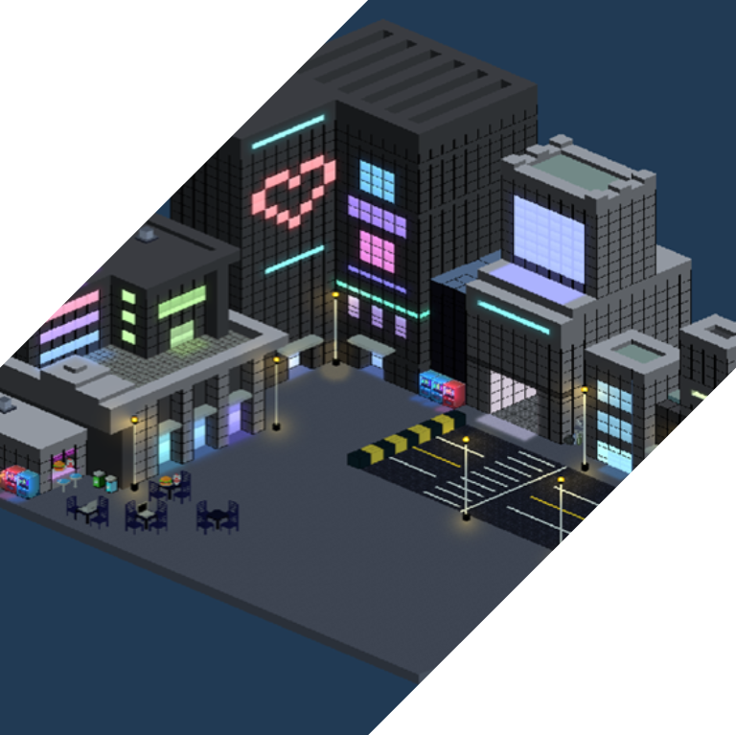
Slide not finished
Game
Aliens are here.
They have imposed an RPG-style game system upon the inhabitants of Earth.
FIGHT!

Slide 6
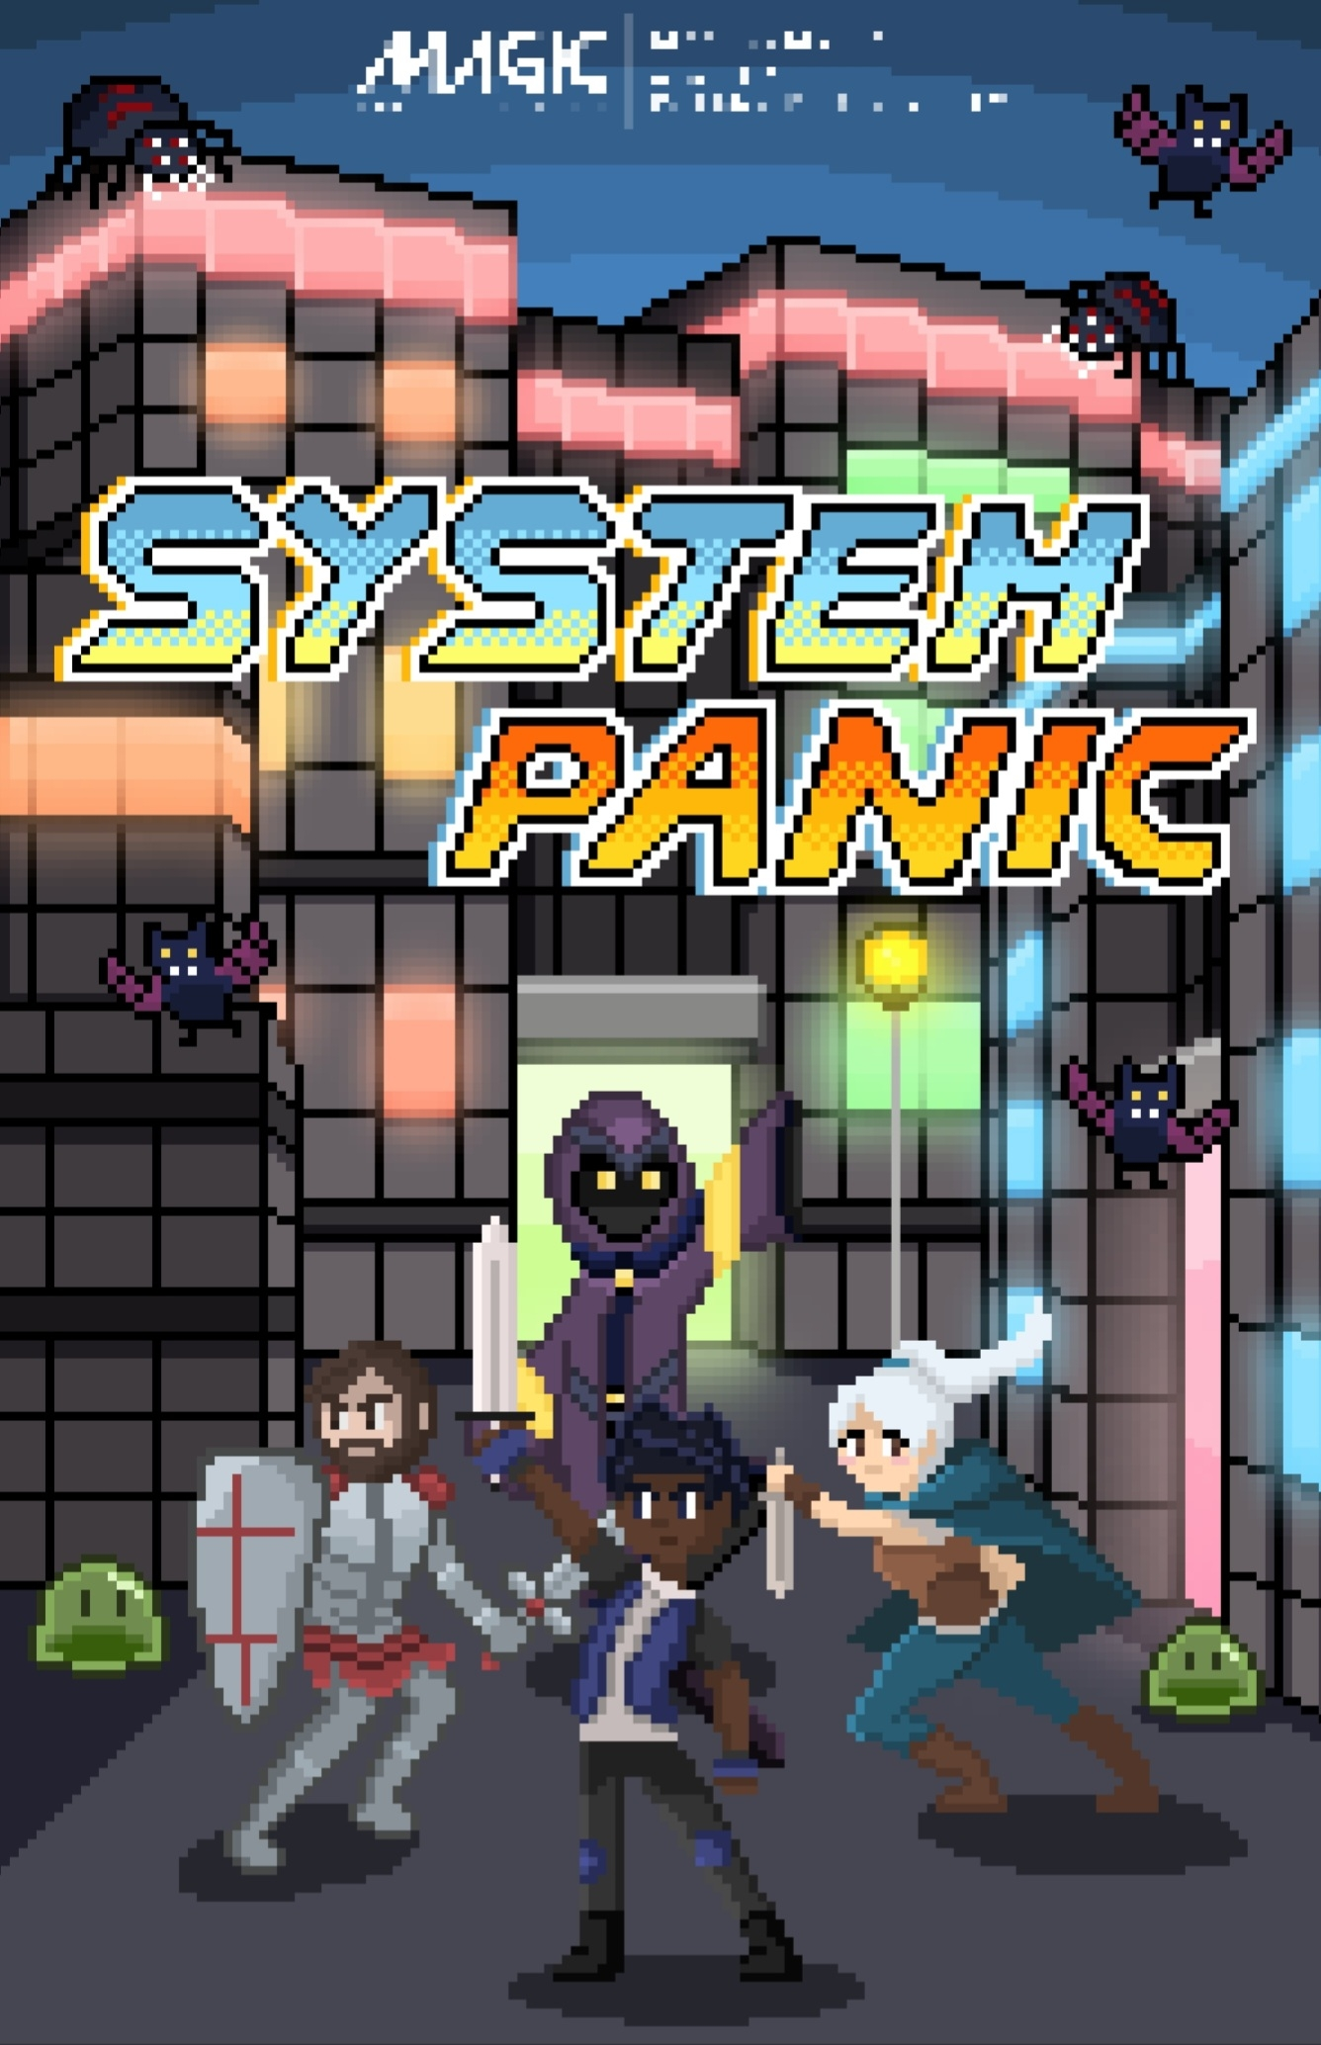

Poster
Special thanks to
Purrrfect Tactics’ own:
Bianca!!

Slide 7
Art

Slide 8
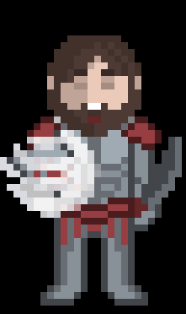
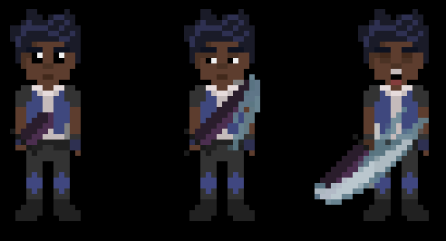
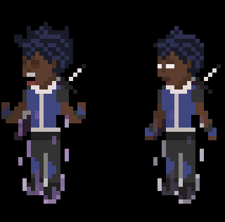
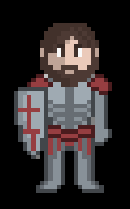
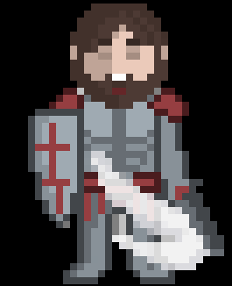
Player Art
Fighter
Tank

Slide 9

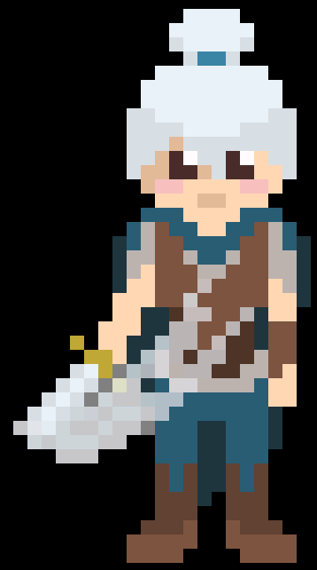
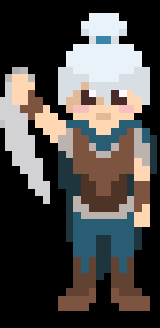
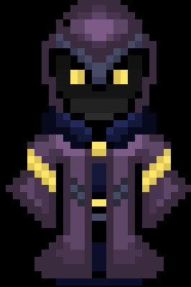

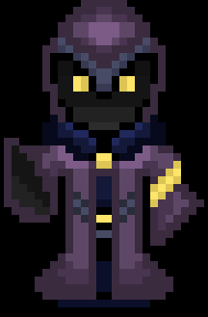
Rogue
Mage

Slide 10
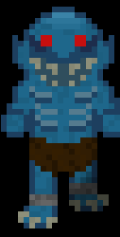
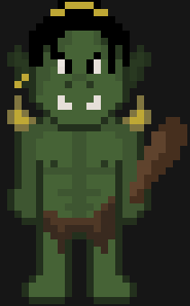
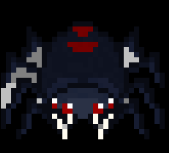

Art - Enemies
Spider
Slime
Ghoul
Orc

Slide 11
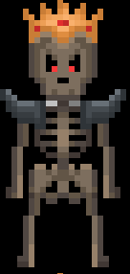
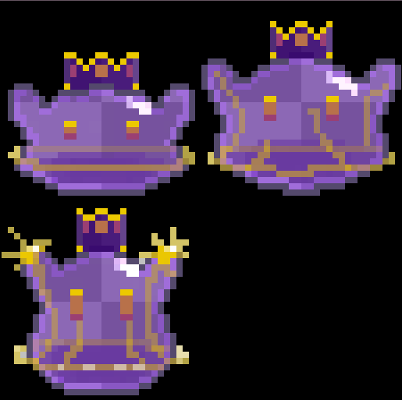
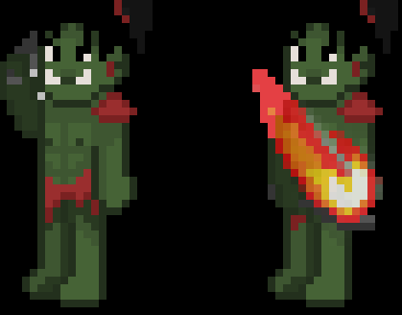
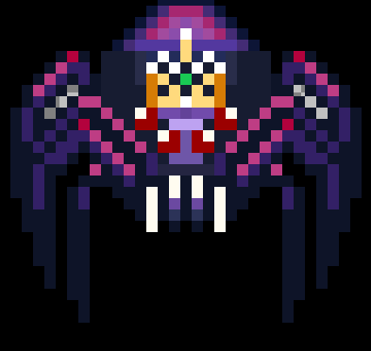
King Skeleton
King Slime
King Orc
Queen Spider
Art - Bosses

Slide 12
Level Design

Slide 13
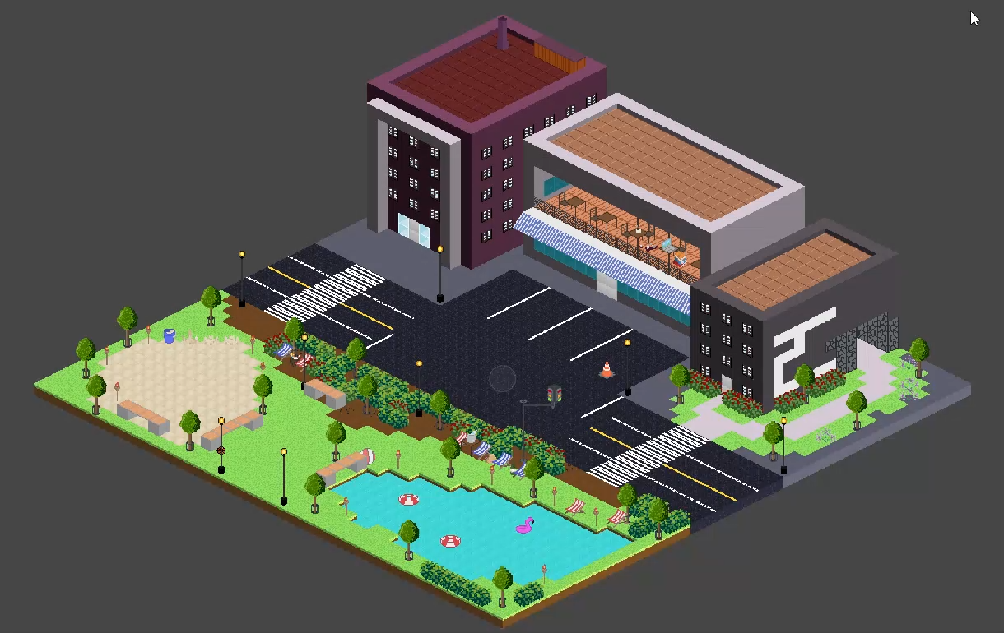
Lighting and Post Processing

Slide 14
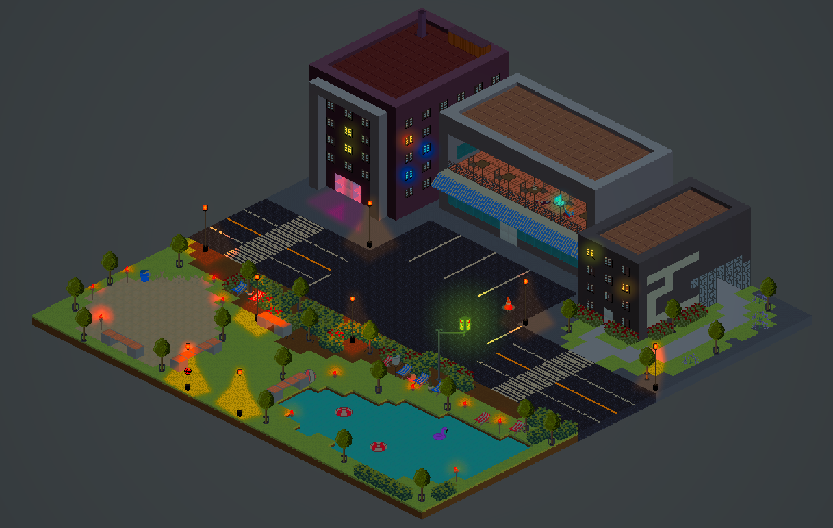
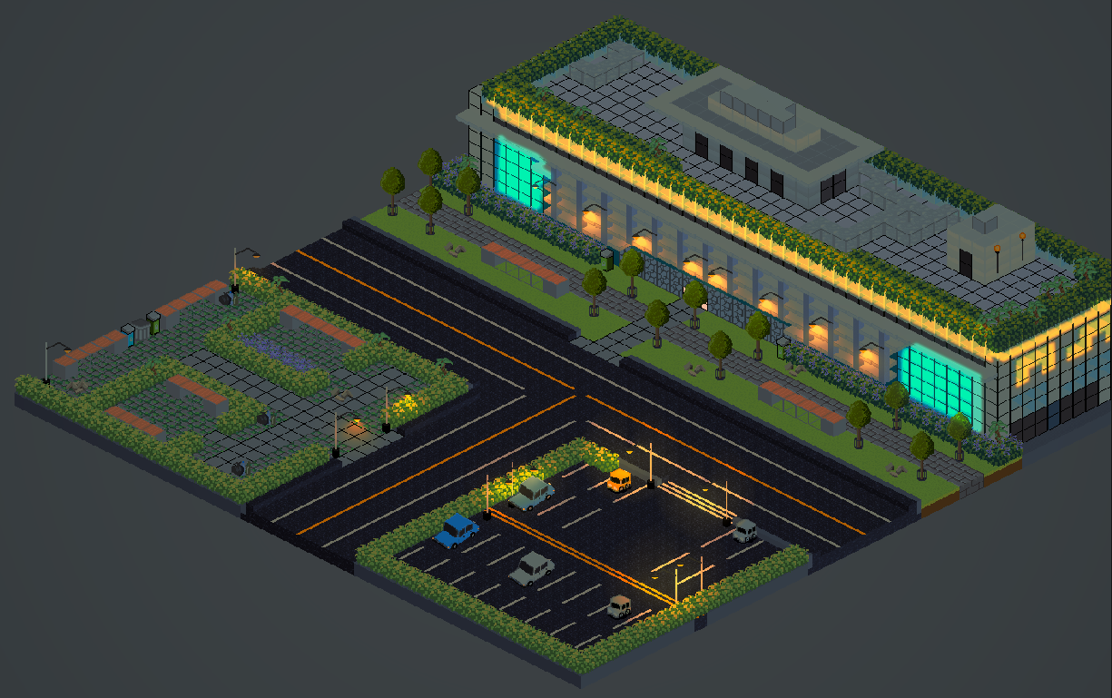
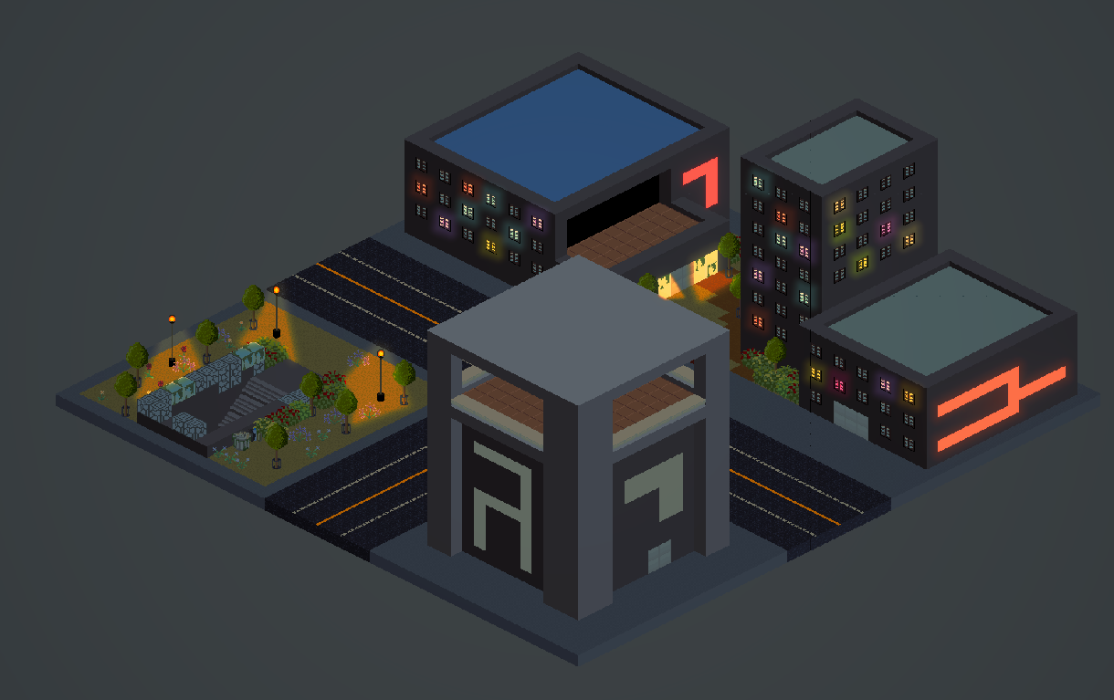
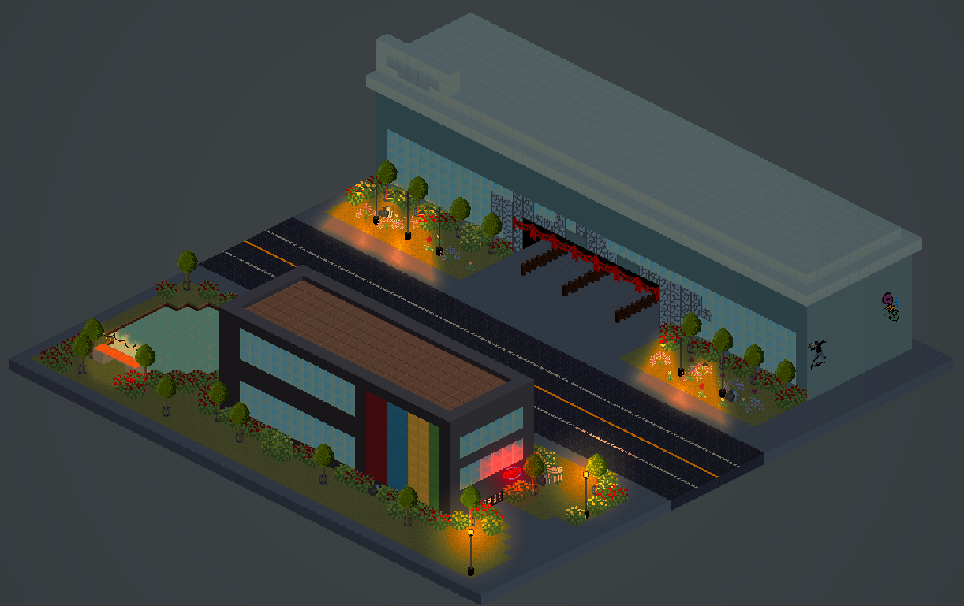
Some
Intersections

Slide 15
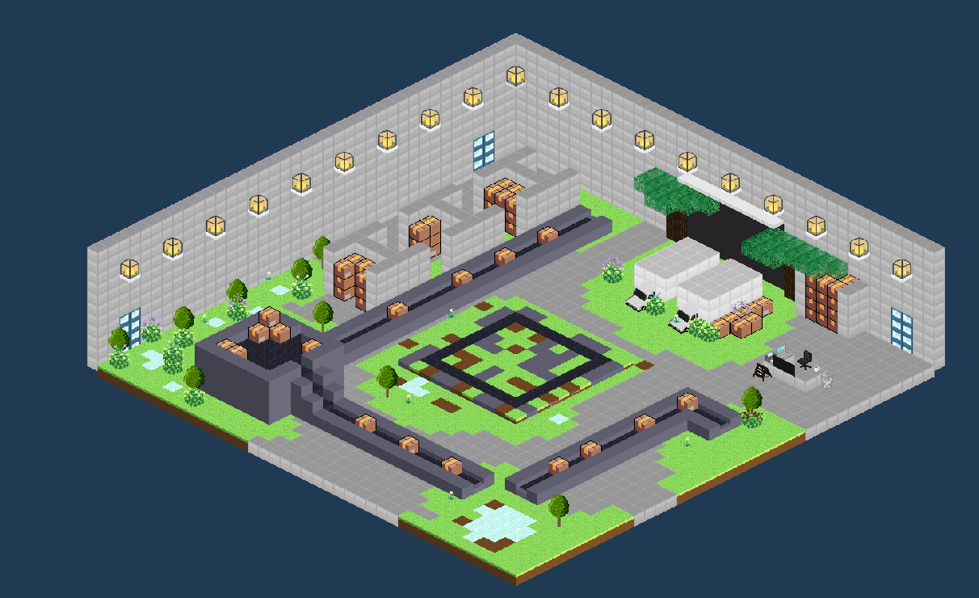
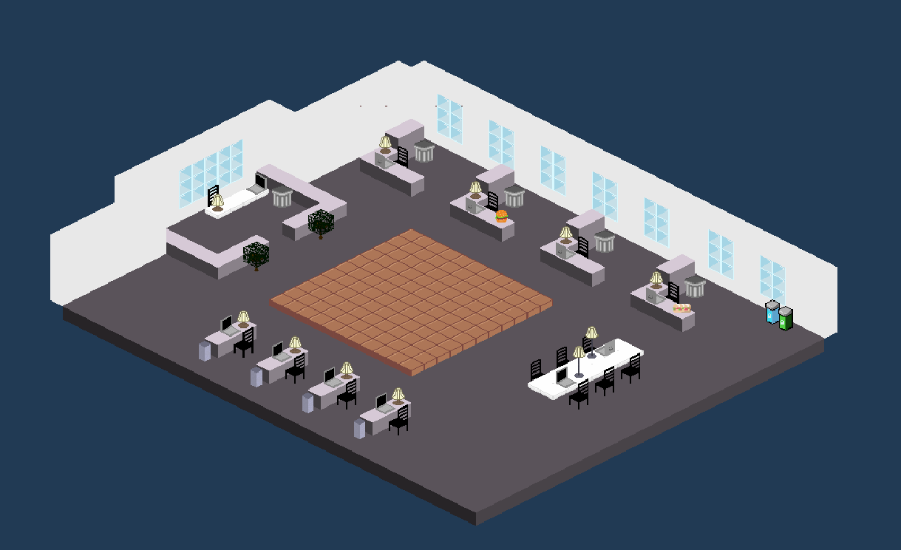
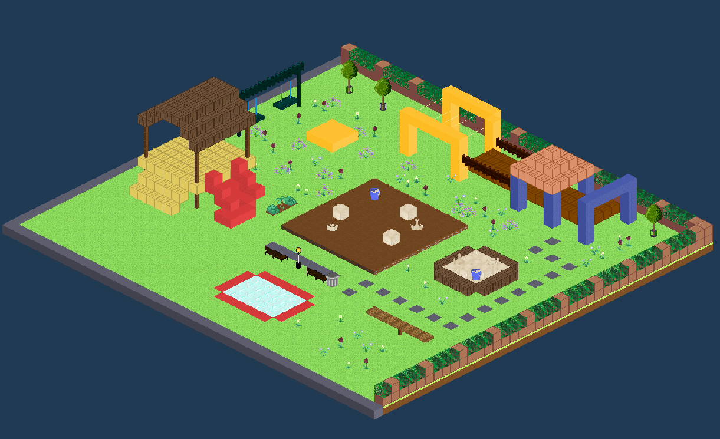
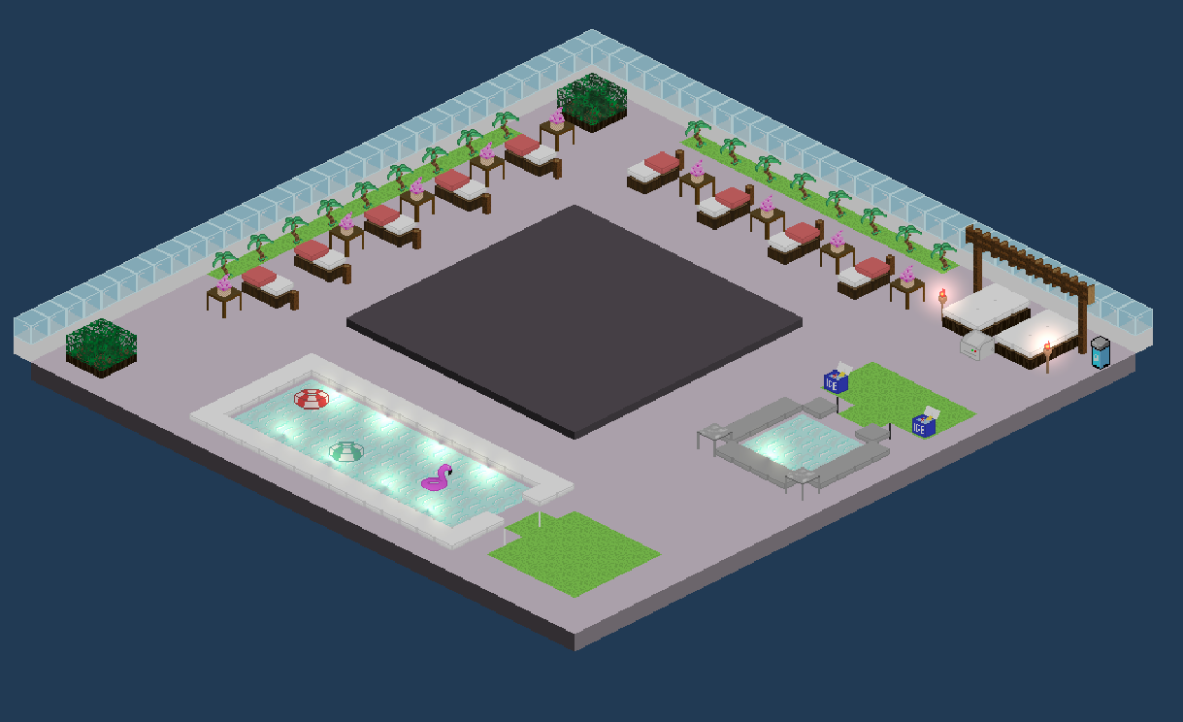
Some
Dungeons

Slide 16

Generation

Slide 17
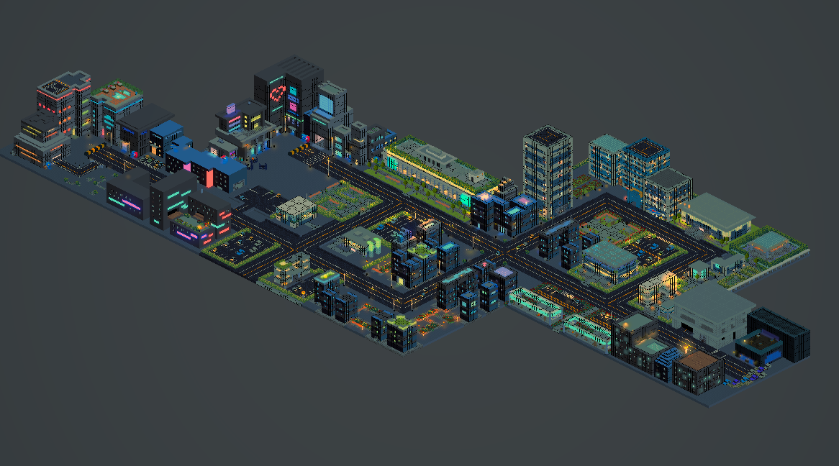
Generation

Slide 18
Thanks!
Questions? Feedback?

